Slide 1
Database management systems
lecture 10. SQL. Data Definition

Slide 2
DDL
Recall that the Data Definition Language (DDL) is the part of SQL that allows one to set up a database’s schema, that is, to define attributes, domains for those attributes, defines tables, define relationships among those tables and so on.

Slide 3
Start with an attribute
One of the smallest units one defines is an attribute.
An attribute is given a name (identifier) and assigned a type.

Slide 4
An identifier by any other name
An SQL identifier is the name assigned to a table, column, view, etc.
The identifier is a string of characters from some set.
The string is at most 128 characters long.
The standard set of characters consists of capital letters (A,B,..), small letters (a,b,…), digits (0,1,…) and the underscore character (_).
An identifier starts with a letter.
An identifier contains no spaces (allowed by Access but not by standard SQL).

Slide 5
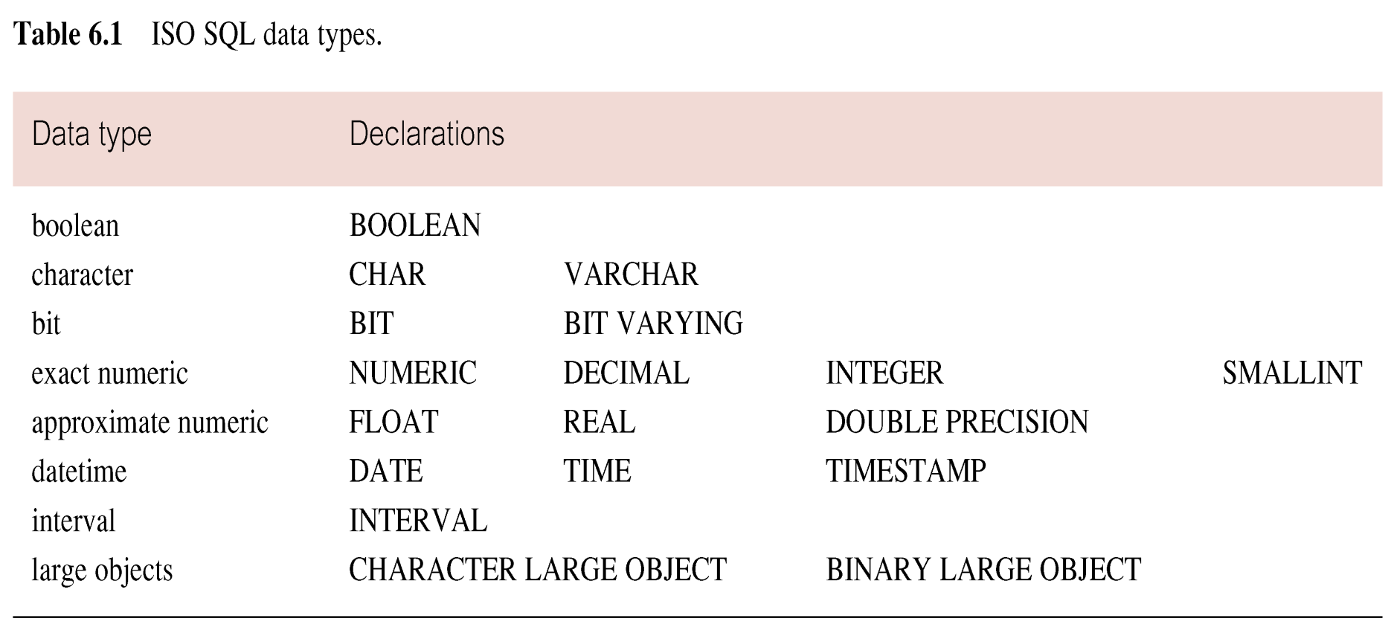
SQL Data Types

Slide 6
BOOLEAN
A Boolean variable is one that is either true or false.
In the RealPerson table in the Simpsons database, regular was a Boolean. Either one is a regular employee of the Simpsons or one is not.
In some cases, there may be a third choice for a Boolean variable: NULL.

Slide 7
CHAR and VARCHAR
CHAR and VARCHAR are character strings
When defining an attribute of the character type, one includes a length
characterID CHAR(6)
fName VARCHAR(30)
the CHAR variable must have the specified length, whereas the VARCHAR variable can be up to the specified length.

Slide 8
INTEGER and SMALLINT
Used for whole numbers, such as: 56, 0 or –77
There is not always a distinction between INTEGER and SMALLINT, but if there is SMALLINT is used if the numbers are fairly small and one wants to save space.
rooms SMALLINT
population INTEGER

Slide 9
NUMERIC and DECIMAL
Used for numbers that have an exact fractional part.
They have a PRECISION (total number of digits) and a SCALE (number of digits after the decimal place).
The number 1234.56789 has a PRECISION of 9 and a SCALE of 5.
The implementation will have a default PRECISION and SCALE to use if they are not specified.
Salary DECIMAL(7,2)

Slide 10
NUMERICAL vs DECIMAL
NUMERICAL is stricter on the limits of possible numbers.
For example, with PRESICION 9 and SCALE 5,
the largest NUMERICAL value is strictly 9999.99999
The largest DECIMAL value may be larger if the implementation can handle it

Slide 11
FLOATS, REALS, etc.
In floating point numbers (like scientific notation 6.022 × 10²³), the decimal place moves and digits on the right-hand side (least significant) might be dropped during various calculations.
This allows for a larger range of numbers, but the numbers are handled somewhat more approximately.

Slide 12
DATE and TIME
Used for variables that track when something happened.
DATE keeps track of year, month and day.
TIME keeps track of hours, minutes and seconds.
TIME can have a precision argument to specify what fractional part of seconds are tracked.
originalAirDate DATE

Slide 13
Establishing Domains for Attributes
The type tells the computer how to interpret data.
The type also puts restrictions on the values the data is allowed to have.
Further restrictions can be placed on the data by introducing a domain constraint.
A domain is an allowed set of values.

Slide 14
NULL or NOT NULL
A simple but important domain constraint is whether or not a value is allowed to be NULL.
NULL is used if the data is unknown or not applicable.
NULL is distinct from 0 for numbers and “” (the empty string) for characters.
The SQL key words are NULL and NOT NULL
NULL means the data can have the NULL value
NOT NULL means it cannot

Slide 15
NULL is the default
If nothing is said, NULL is implied.
For example, in the Character table in the Simpsons database
lName VARCHAR(30)
lName VARCHAR(30) NULL
would be the same and say that a character may not have a last name
characterID CHAR(6) NOT NULL
says that a character must have an ID.

Slide 16
CHECK: For More Restrictions on Domain
CHECK(condition) verifies that the value obeys some condition
jobPos VARCHAR(15) CHECK(jobPos IN
(‘actor’, ‘producer’))
allows values of ‘actor’, ‘producer’ or NULL for the jobPos.
wage DECIMAL(5,2) CHECK(wage > 5.25 AND wage < 500.00)

Slide 17
DOMAIN: making a more restrictive type
The SQL keyword DOMAIN allows one in a sense to define one’s own type, provided that type is a restriction on a standard type.
CREATE DOMAIN JobType AS VARCHAR(15) CHECK(VALUE IN
(‘actor’, ‘producer’))
jobPos JobType

Slide 18
DEFAULT
One can specify a value from the domain to use as a default
CREATE DOMAIN LevelType AS VARCHAR(15) DEFAULT ‘Beginner’ CHECK(VALUE IN (‘Beginner’, ‘Intermediate’, ‘Advanced’)

Slide 19
Collecting Attributes to make a Table
After defining attributes and their domains, one collects the attributes together to create a table.
Some of the attributes will play special roles in the table, for instance, they may act as the primary key, a candidate key or a foreign key.

Slide 20
PRIMARY KEY
Recall that no part of a primary key can be NULL and that the primary key must uniquely identify a record (known as Entity Integrity).
The keyword PRIMARY KEY specifies that attribute(s) will serve this purpose.
PRIMARY KEY(characterID)
PRIMARY KEY(episodeID, characterID)

Slide 21
Candidate Keys
Recall that a candidate key is an attribute or set of attributes having the same features as the primary key (uniqueness).
To specify that a set of attributes must have this uniqueness property, use the keyword UNIQUE
PRIMARY KEY(date, time, room)
UNIQUE(date, time, tutee)
UNIQUE(date, time, tutor)

Slide 22
Foreign Keys
Recall that a foreign key is an attribute in a table that is either NULL or must match a value from another table (called Referential Integrity).
It realizes a relationship between two tables.
The SQL is
FOREIGN KEY (personID) REFERENCES RealPerson

Slide 23
What happens to old relationships?
A foreign key takes it values from another table (its parent in the relationship). What happens if the parent value is updated or deleted?
How will referential integrity be maintained?

Slide 24
Four choices for maintaining referential integrity
CASCADE: make same update to child as made to parent
SET NULL: set the child value to NULL when the parent is updated
SET DEFAULT: set the child value to its DEFAULT when the parent is updated
NO ACTION: prevent parent from being updated if children are affected

Slide 25
ON DELETE / ON UPDATE
Different choices can be specified depending on what is happening to parent
FOREIGN KEY (stateSymbol) REFERENCES State ON DELETE NO ACTION
FOREIGN KEY (stateSymbol) REFERENCES State ON UPDATE CASCADE

Slide 26
Enterprise Constraints
An enterprise constraint (a.k.a. a business rule) is an additional condition placed on the database that does not fall into one of the previous categories of domain constraint, entity integrity and referential integrity.
An example would be allowing a video store customer to have out at most ten items at any time.

Slide 27
Imposing Enterprise Constraints
The SQL keyword ASSERTION is used to impose enterprise constraints.
CREATE ASSERTION PreventTooManyItems
CHECK( NOT EXISTS(SELECT custID
FROM ItemsCurrentlyOut
GROUP BY custID
HAVING COUNT(*) >10))

Slide 28
Main DDL statements
SQL allows one to create, alter and destroy domains, tables, views and schemas.
The main SQL DDL statements are:
CREATE SCHEMA, DROP SCHEMA
CREATE DOMAIN, ALTER DOMAIN, DROP DOMAIN
CREATE TABLE, ALTER TABLE, DROP TABLE
CREATE VIEW, DROP VIEW

Slide 29
Environment/Catalog
Database objects exist in an environment.
Each environment contains one or more catalogs, and each catalog consists of set of schemas.
A schema is a named set of related database objects.
Objects in a schema include domains, tables, assertions, views, and so on.
All of the objects have the same owner.

Slide 30
CREATE TABLE TableName
{(colName dataType [NOT NULL] [UNIQUE]
[DEFAULT defaultOption]
[CHECK searchCondition] [,...]}
[PRIMARY KEY (listOfColumns),]
{[UNIQUE (listOfColumns),] […,]}
{[FOREIGN KEY (listOfFKColumns)
REFERENCES ParentTableName [(listOfCKColumns)],
[ON UPDATE referentialAction]
[ON DELETE referentialAction ]] [,…]}
{[CHECK (searchCondition)] [,…] })
Define fields
Identify primary key
Identify candidate keys
Identify foreign keys, relationships and actions to maintain referential integrity.
Business rules

Slide 31
CREATE DOMAIN OwnerNumber AS VARCHAR(5)
CHECK (VALUE IN (SELECT ownerNo FROM PrivateOwner));
CREATE DOMAIN StaffNumber AS VARCHAR(5)
CHECK (VALUE IN (SELECT staffNo FROM Staff));
CREATE DOMAIN PNumber AS VARCHAR(5);
CREATE DOMAIN PRooms AS SMALLINT;
CHECK(VALUE BETWEEN 1 AND 15);
CREATE DOMAIN PRent AS DECIMAL(6,2)
CHECK(VALUE BETWEEN 0 AND 9999.99);

Slide 32
CREATE TABLE PropertyForRent (
propertyNo Pnumber NOT NULL, ….
rooms Prooms NOT NULL DEFAULT 4,
rent Prent NOT NULL, DEFAULT 600,
ownerNo OwnerNumber NOT NULL,
staffNo StaffNumber
Constraint StaffNotHandlingTooMuch ….
branchNo BranchNumber NOT NULL,
PRIMARY KEY (propertyNo),
FOREIGN KEY (staffNo) REFERENCES Staff
ON DELETE SET NULL ON UPDATE CASCADE ….);

Slide 33
ALTER TABLE
The ALTER TABLE keyword is used to change the schema (not the instance) of a table. For example, one can
Add a new column to a table.
Drop a column from a table.
Add a new table constraint.
Drop a table constraint.
Set a default for a column.
Drop a default for a column.

